Slide 1
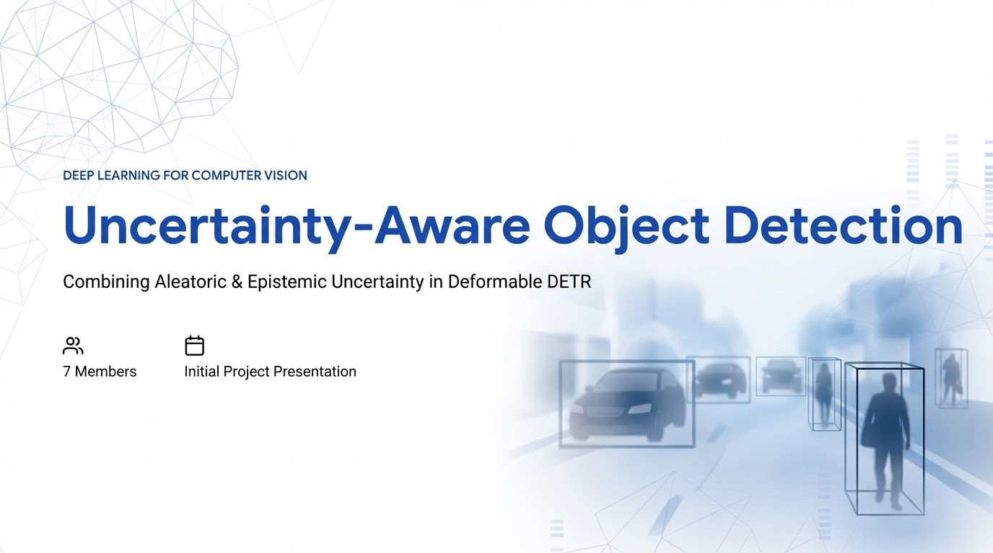

Slide 2

















Team Members
Deep Learning for Computer Vision Course Project
Maradana Kasi Sri Roshan
Krishna Kumar Bais
Mahathi Garapati
Daksh Kumar Singh
Sontam Deekshitha
Chinthapudi Gowtham Chand
Sevak Baliram Shekokar

Slide 3

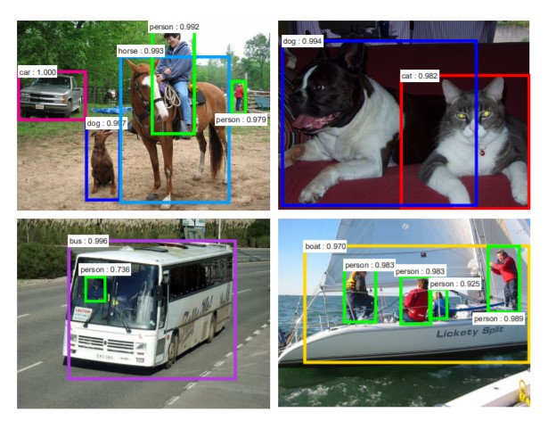

Problem Statement
Safety-Critical Failures
Build an object detector that knows when it should NOT be trusted by separating image-level noise from model-level ignorance, providing calibrated confidence scores.
Overconfident Scores: Current detectors output a softmax score (e.g. 80%) that doesn't reflect true reliability. They can be wrong with no warning.
No Uncertainty Separation: A blurry image (data problem) and a rare object class (model problem) require different responses, but are treated identically.
Poor Calibration (High ECE): For DETR and Deformable DETR, '80% confident' does not mean 80% accurate. They are systematically overconfident.
Unsafe for Deployment: In autonomous driving or medical imaging, silent failures are dangerous.

Slide 4
Research Paper / Author | Core Methodology | Key Findings | Primary Limitations
Retinexformer: One-Stage Retinex-Based Transformer for Low-Light Image Enhancement | Uses Retinex theory with a transformer to separate illumination and reflectance for low-light enhancement. | Improves visibility and feature quality in low-light images, helping downstream vision tasks. | Designed for image enhancement, not object detection; adds preprocessing overhead.
U-Net: Convolutional Networks for Biomedical Image Segmentation | Encoder–decoder CNN with skip connections for precise image segmentation. | Performs well even with limited training data and became a foundational segmentation architecture. | Designed for segmentation rather than detection; does not model prediction uncertainty
GenConViT: Generative Convolutional Vision Transformer for Deepfake Detection | Hybrid model combining CNN and Vision Transformer to detect deepfake artifacts in images and videos. | Achieves strong accuracy in detecting manipulated media using spatial and generative features. | Focused on classification tasks; computationally heavy and not designed for object detection
End-to-End Object Detection with Transformers (DETR) | Transformer encoder-decoder architecture for object detection using object queries and bipartite matching loss | Removes anchors and NMS, enabling simple end-to-end detection framework. | Very slow training (~500 epochs) and weak performance on small objects.
Deformable DETR: Deformable Transformers for End-to-End Object Detection | Introduces deformable attention where each query attends to a small set of reference points instead of full attention. | Faster convergence (~50 epochs) and improved small-object detection compared to DETR. | Still computationally expensive and does not estimate prediction uncertainty.

Slide 5
Research Paper / Author | Core Methodology | Key Findings | Primary Limitations
What Uncertainties Do We Need in Bayesian Deep Learning for Computer Vision? | Bayesian framework modeling aleatoric uncertainty via variance prediction and epistemic uncertainty using Monte Carlo dropoout | Demonstrates improved robustness and uncertainty estimation in vision tasks like segmentation and depth estimation. | Not designed for object detection models; Monte Carlo sampling increases inference cost.
Bayes R-CNN: Uncertainty-Aware Bayesian Object Detection for Remote Sensing | Extends Faster R-CNN with Bayesian layers and multi-resolution feature extraction for uncertainty estimation. | Improved detection accuracy and interpretability in remote sensing datasets. | Very complex architecture; computationally heavy and tested only on specialized remote-sensing datasets.
Gaussian YOLOv3: Localization Uncertainty for Object Detection | Models bounding box prediction as a Gaussian distribution and predicts variance along with bounding box coordinates. | Improved mAP by ~3–3.5 points on KITTI and BDD datasets while running in real time (~42 FPS). | Only models localization (aleatoric) uncertainty; does not capture epistemic uncertainty; assumes Gaussian noise for all objects.
An Uncertainty-Weighted Decision Transformer for Navigation in Dense, Complex Driving Scenarios | Decision Transformer using entropy-based uncertainty weighting during training. | Improves reward, stability, and reduces collision rate in dense traffic navigation tasks. | Tested mainly in simulation; requires large datasets and high computation.
Capturing Object Detection Uncertainty in Multi-Layer Grid Maps | Uses CNNs to estimate classification, pose, and shape uncertainty in grid-map representations used in autonomous driving. | Shows that uncertainty helps improve robustness and trajectory planning safety. | Designed specifically for grid-map sensor fusion data; not applicable directly to image-based object detectors.

Slide 6
Research Paper / Author | Core Methodology | Key Findings | Primary Limitations
Towards Safe Autonomous Driving: Capture Uncertainty in Deep Neural Networks for LiDAR 3D Vehicle Detection | Bayesian neural network applied to LiDAR 3D object detection with aleatoric and epistemic uncertainty modeling. | Modeling aleatoric uncertainty improved detection accuracy by ~1–5%. | Focused on LiDAR data and 3D detection; not directly applicable to 2D image detectors.
Uncertainty-Aware Gradient Stabilization — Huixin Sun et al., ICCV 2025 | Reformulates localization as discrete intervals; Uncertainty-Minimization loss and uncertainty-guided refinement stabilize gradients for tiny boxes | Reduces gradient variance ≈2.9×; improves small-object AP (≈+2.6 on VisDrone); generalizes across detectors. | Adds UM & UR modules (more complexity); discretization may slightly reduce fine localization precision; small-object focus.
Calibrated Detection Transformer (Cal-DETR) — Munir et al., NeurIPS 2023 | Train-time calibration: uncertainty quantification, uncertainty-guided logit modulation, plus logit-mixing regularizer for DETR variants. | Significantly lowers calibration error (ECE); maintains AP; improves in- and out-of-domain confidence reliability. | Adds training overhead and extra losses; needs tuning of modulation/mixing hyperparameters for best results.
GroupEnsemble: — Yang et al., arXiv 2026. | Run multiple object-query groups in parallel through shared decoder; attention masks keep groups independent producing ensemble outputs. | Produces ensemble - quality uncertainty in one forward pass; better-cost-accuracy tradeoff than naive ensembles or MC-dropout. | Increases memory and inference overhead; assumes transformer parallelism; slightly more complex integration than single models.
Out-of-Distribution Object Detection through Bayesian Uncertainty Estimation — Tianhao Zhang et al., | Samples detector weights from Gaussian distributions to estimate Bayesian uncertainty and detect out-of-distribution objects. | Improves OOD detection performance; reduces FPR95 and increases AUROC when testing detectors on unseen datasets. | Requires weight sampling during inference; additional computation compared to standard deterministic detectors.

Slide 7
Research Paper / Author | Core Methodology | Key Findings | Primary Limitations
E-DETR: Evidential Deep Learning for End-to-End Uncertainty Estimation in Object Detection | Extends DETR with evidential deep learning to estimate uncertainty distributions instead of point predictions. Uses Beta distribution for classification and NIG distribution for bounding box regression. | Provides end-to-end uncertainty estimation in object detection. Improves calibration, robustness, and generalization, especially on imbalanced datasets. | Sensitive to class imbalance and requires careful tuning of evidential regularization. Additional uncertainty modeling increases training complexity.
Uncertainty Meets Diversity: A Comprehensive Active Learning Framework for Indoor 3D Object Detection | Active learning framework combining uncertainty-based sampling with diversity selection using a class-aware adaptive prototype bank. | Improves label efficiency and detection performance by selecting informative and diverse indoor 3D scenes. | Requires iterative retraining and annotation cycles; effectiveness depends on uncertainty estimation quality.
Monte Carlo DropBlock for Modelling Uncertainty in Object Detection – Deepshikha Kumari et al. | Introduces MC-DropBlock, applying DropBlock regularization during training and inference to perform multiple stochastic forward passes and estimate uncertainty in object detection models. | Improves uncertainty estimation and calibration in CNN-based detectors. Enhances robustness and helps detect unreliable predictions and out-of-distribution inputs. | Requires multiple inference passes which increases computational cost. Performance depends on correct tuning of DropBlock parameters
Exploring Aleatoric Uncertainty in Object Detection via Vision Foundation Models | Uses foundation-model features and Mahalanobis distance to estimate aleatoric data uncertainty for each object instance. | Enables uncertainty-aware sample filtering and adaptive training; improves robustness against noisy annotations and difficult objects. | Depends on quality of foundation-model features; additional feature extraction and clustering increase computation.

Slide 8
Research Paper / Author | Core Methodology | Key Findings | Primary Limitations
DETR with Improved DeNoising Anchor Boxes for End-to-End Object Detection — Hao Zhang et al., ICLR 2023 | Improves DETR by introducing contrastive denoising training, mixed query selection for anchor initialization, and improved bounding-box prediction, enabling faster convergence and stronger detection performance. | Achieves state-of-the-art object detection accuracy (e.g., >63 AP on COCO with large models) while training significantly faster than earlier DETR variants. | Still computationally heavy; requires large datasets and strong backbones (e.g., Swin Transformer) to reach top performance.
YOLO: You Only Look Once (Joseph Redmon et al.) | Single CNN predicts bounding boxes and classes from whole image using an S×S grid. | Real-time detection, simple end-to-end pipeline, fewer background errors. | Poor localization for small objects, grid limits multiple nearby detections.

Slide 9
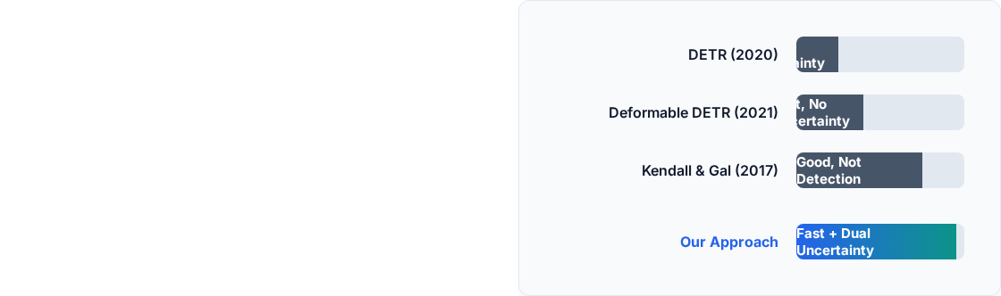
Comparison of Existing Approaches
The Gap Our Project Fills
No transformer detector has been extended with both aleatoric AND epistemic uncertainty estimation.
DETR and Deformable DETR lack calibration completely.
Kendall & Gal's foundational method was never applied to object detection.
MC Dropout at T=50 is too slow. We show T=10 decoder-only dropout achieves comparable quality at 10x overhead.

Slide 10


Understanding The Two Failure Modes
Aleatoric Uncertainty
Epistemic Uncertainty
Failure Mode 1: Data
Failure Mode 2: Model
Uncertainty in the DATA. The image is ambiguous (blurry, dark). It is IRREDUCIBLE. Modeled via: Variance head predicting σ2. Response: High σ2 means sensor fusion or re-capturing is needed.
Uncertainty in the MODEL. It hasn't seen enough of this object class. It is REDUCIBLE. Modeled via: Monte Carlo Dropout (T=10). Response: High variance means flag for human review or collect more training data.

Slide 11




Proposed Approach
Research Question:
WHAT
WHAT
WHAT
WHAT
Keep dropout ON at test time in decoder FFN layers. Run T=10 stochastic forward passes. Variance across runs = epistemic uncertainty.
Use from Track A to compute per-image sample weights. Fine tune with weighted loss – hard images get more training attention
Add a parallel variance branch to the detection FFN head. Fine-tune only the new head (backbone frozen). Outputs per detection
Use from Track A to compute per-image sample weights. Fine tune with weighted loss – hard images get more training attention
coordination
WHY
Zero retraining. Deformable DETR already has dropout in decoder. Only ~10× overhead.
WHY
WHY
No existing transformer-based detector outputs uncertainty — we are the first to add it to Deformable DETR. Directly models data-level noise from Kendall & Gal.
WHY
Uses uncertainty to improve training on hard examples. May improve APs on small/occluded objects.
Uses uncertainty to improve training on hard examples. May improve APs on small/occluded objects.

Slide 12


Progress Till Now
Completed
In Progress / Upcoming
Literature Review: All core papers reviewed and connected to project limits.
Track A: Variance head architecture designed; heteroscedastic loss implementation started.
Dataset Prep: COCO val2017 (~1GB, 5k images) and 20k subset of train2017 identified.
Track B (Upcoming): MC Dropout inference loop planned for Week 2 (T=5, 10, 20).
Baseline Loading: Loaded official Deformable DETR checkpoint. Verified baseline AP=43.8.
Eval Pipeline: ECE calculation, reliability diagrams code to be built alongside Track B.

Slide 13







Final Deliverables
Trained Model & Eval
Ablation Study
Code & Report
Deformable DETR + uncertainty heads (Tracks A/B/C) on COCO. Evaluation AP, ECE, reliability diagrams.
Systematic comparison of dropout rate, T passes (5/10/20), fine-tuning epochs. Compute vs Performance analysis.
Full technical report, live demo with uncertainty visualization heat maps, and reproducible GitHub codebase.

Slide 14



Project Timeline (Mar 3 - Apr 25, 2025)
Mar 21
Apr 21 - 25
Baseline Model
Implementation
Final Demo & Sub Phase 3 Complete
Today
Apr 6 & 14
Initial Presentation Phase 1 Setup
Results & Report Experiments

Slide 15
